Slide 1
Project Selection and Prioritisation

Slide 2
Strategy and Portfolio Management
Expansion
Program
Upgrades
Refurbs
Portfolio
Short term Health Infra
Long term Health Infra
Mobile Health
New facilities
Mobile Cinics
Strategy – Provide quality and accessible healthcare
Notes:
Portfolio Management “aligns with organisational strategies by selecting the right projects, prioritising work, and providing needed resources”
Programs deal with a specific group of related projects, while a portfolio deals with all of an organisation’s projects/programs.
(program is “a group of related projects, sub-programs, and program activities managed in a coordinated way to obtain benefits not available from managing them individually”

Slide 3

Project identification and selection
A project charter is a document that formally authorises the project that has been selected.
Project identification
Project selection
Evaluation & Prioritsation
Market Demand
Financial
What value does the potential project bring?
1
NPV
BCR
IRR
Payback Period
Strategic opportunity
Are the resources available?
Is there support from both internal champions and external customers
Scoring
2
Customer request
Identify potential criteria
Determine mandatory criteria
Weighting criteria
Will the project help the organisation achieve its goal?
Notes:
Identifying Potential Criteria - “These criteria should include how well each potential project fits with the organisation’s strategic planning. The criteria may also include items such as risk, timing, resources needed
Determining Mandatory Criteria - “That is, are there any situations that dictate a project must be chosen regardless of any other considerations? Examples of this include government mandates and safety/security situations.

Slide 4
Activities
You are a senior manager at Pepsi SA tasked with identifying projects to help achieve the company's goal improving the brand awareness. Use a SWOT analysis to identify projects that can help achieve this?
Notes:
shows the typical life-cycle phases that an organization goes through to implement project management. In the first phase, the Embryonic Phase, the organization recognizes the apparent need for project management. This recognition normally takes place at the lower and middle levels of management where the project activities actually take place. The executives are then informed of the need and assess the situation.

Slide 5
Organisation capability

Slide 6
Organisation culture
Responsibility
Respect
Guidelines for
Project Manager
Fairness
Honesty
Transparency
Courage

Slide 7
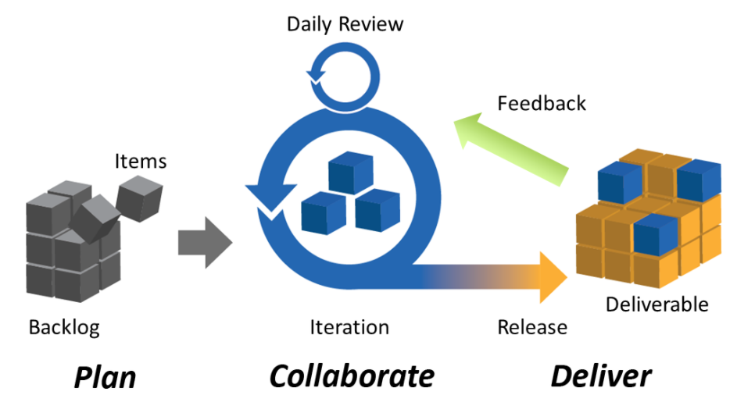
Agile Project Management
Notes:
if the scope is difficult to define at an early stage of the project or if there is much change that is expected then a change-driven or agile approach would be a better option as it is known to often work better.

Slide 8
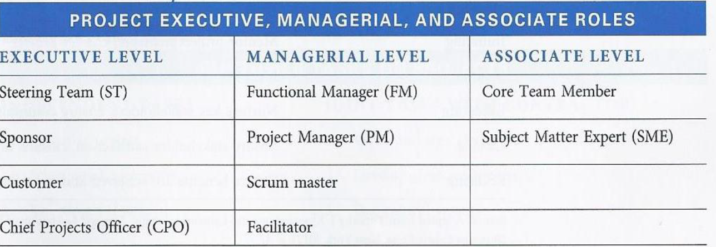
Organisation culture
Notes:
The duties of the steering team are around the following five activities: Overall priority setting, Project selection and prioritisation, Sponsor selection, General guidance and Encourag
“PMI defines a sponsor as “the person or group who provides resources and support for the project and is accountable for enabling success for the project
The CPO responsibilities is to insure that the company’s steering team does the following:
➢ Identify potential projects during strategy planning phase.
➢ Select a manageable set of projects that are to be implemented.
➢ Prioritises effectively within the selected projects.
➢ Ensure that there are enough resources such as people, money and other resources available to perform the projects.

Slide 9
Chartering Projects

Slide 10
Project identification and selection
A project charter is a document that formally authorises the project that has been selected.
Project identification
Project selection
Project charter
Need
1
Project title
Develop a set of criteria against which the project will be evaluated.
2
Scope overview
3
Business case
Problem
List assumptions.
4
Background
Gather data and information for each project.
5
Risks, Assumptions
6
Funding
Opportunity
7
Major deliverables
Evaluate each project against the criteria.
8
Acceptance criteria
9
Milestone schedule

Slide 11
Stakeholder analysis and communication planning

Slide 12
Stakeholders
1. Work on project
2. Provide resources
2. Routine disrupted
External
Government
Community
Customers
Environmental Groups
Internal
Project Sponsor
CEO
Functional departments
Administration
“A principle idea in agile is that relationships with stakeholders need to be based upon collaboration, communication, and trust. Analysing stakeholder information helps the team understand them better and leads to effective relationship building”
Notes:
Identifying stakeholders is “the process of identifying the people, groups, or organisations who could impact or be impacted by a decision, activity, or outcome of the project

Slide 13
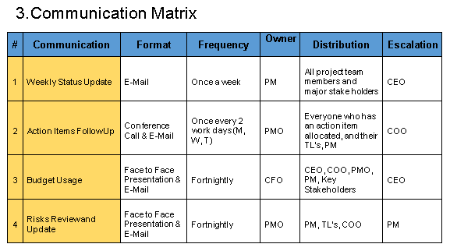
Communications Plan
Who does the project need to learn from? What does the team need to learn from this stakeholder? Who does the project team need to share with? What does this stakeholder need to know? When do they need to know it? What is the most effective communications method for this stakeholder to understand? Who on the project team is responsible for this communication?
Notes:
Identifying stakeholders is “the process of identifying the people, groups, or organisations who could impact or be impacted by a decision, activity, or outcome of the project

Slide 14
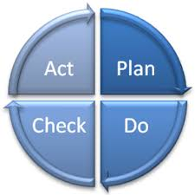
Project Meetings
Establish project plans
Conduct the project activities,
Verify progress
Make decisions,
Accept deliverables
Close out projects.
The plan-do-check-act (PDCA) model may be utilised to improve the meeting process.
Notes:
The Project Manager ensures that the schedule is ready and circulated in advance. If a project team is meeting often, the agenda may be circulated at the end of each meeting for the next meeting. That way, everyone knows what will be covered in the next meeting.
“do” means to carry out the meeting and to take minutes as the meeting proceeds. Project teams swap the minute’s taker role so each member feels equal.
Finally, the “act” part of the PDCA model is for every team member to complete the action items they pledged and for the Project Manager to converse with the team members to ensure nothing is hindering their ability to complete their part of the project.

Slide 15
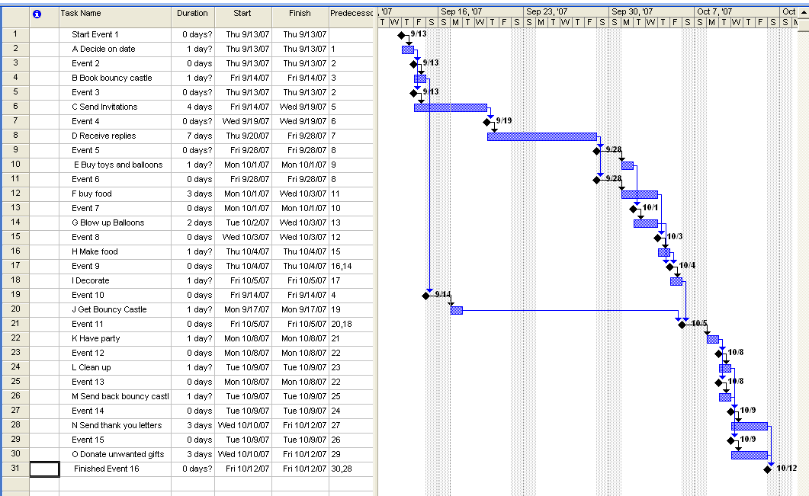
Bouncy Castle Gantt Example using MS Project
In MS Project set the task length to be 0 to get a milestone

Slide 16
PERT Chart Exercise
Task Prec Tasks Description Time(hrs)
A none decide on date for party 1
B A book bouncy castle 1
C A send invitations 4
D C receive replies 7
E D buy toys and balloons 1
F D buy food 3
G E blow up balloons 2
H F make food 1
I H, G decorate 1
J B get bouncy castle 1
K J, I have party 1
L K clean up 4
M K send back bouncy castle 1
N L send thank you letters 3
O M donate unwanted gifts 3

Slide 17
Scope Management

Slide 18
Project Scope Management
“The processes required to ensure that the project includes all the work required, and only the work required, to complete the project successfully”
Answers the question – “What will the project produce in the end”.

Slide 19
How Do We Manage Scope?
Five processes
Collect Requirements
Define Scope
Create WBS
Verify Scope
Control Scope
Collect
Requirements
Define
Scope
Create WBS
Verify
Scope
Control
Scope

Slide 20
Collect Requirements
Inputs
Tools & Techniques
Outputs
Project Charter
Interviews
Focus groups
Facilitated workshops
Group creativity techniques
Group decision making techniques
Questionnaires and surveys
Observations
Prototypes
Requirements docs
Stakeholder Register
Requirements mgmt plan
Requirements traceability matrix
Collect
Requirements
Define
Scope
Create WBS
Verify
Scope
Control
Scope
Notes:
In a Traceability Matrix, the requirements tie “end to end” that is from the contract through to the project testing and to customer acceptance

Slide 21
Define Scope
Inputs
Tools & Techniques
Project Charter
Outputs
Expert judgement
Product analysis
Alternatives identification
Facilitated workshops
Project Scope Statement
Requirements documentation
Project Document Updates
Organizational Process Assets
Collect
Requirements
Define
Scope
Create WBS
Verify
Scope
Control
Scope

Slide 22
Work Breakdown Structure
New Warehouse
Design - 1
Construction - 2
Commissioning - 3
Structural - 1.1
Concrete Install – 2.1
Steel Package 1.1.1
Steel Install – 2.2
Concrete Package 1.1.2
Drywall Install – 2.3
Architectural – 1.2
1st Floor Package 2.3.1
Floor Layout 1.2.1
2nd Floor Package 2.3.2
Elevations 1.2.2
Door Schedule 1.2.3

Slide 23
Scheduling

Slide 24
How Do We Manage Time?
Six processes
Define Activities
Sequence Activities
Estimate Activity Resources
Estimate Activity Durations
Develop Schedule
Control Schedule
Estimate Activity Resources
Estimate Activity Durations
Define
Activities
Sequence
Activities
Develop
Schedule
Control Schedule

Slide 25
Developing the schedule
Firstly, identify all of the activities
Then to determine the logical order by creating a network diagram.
Then assign resources to each activity
Give an estimate of the time required for each activity
Make an adjustment of some kind in the absence of an assigned resource that is not available when the activity is scheduled
Compute all of this information onto the schedule
Compare the emerging schedule with any imposed dates and cash flow estimates
Ensure there are no inconsistencies as these can place demands on the team and create risk factors.

Slide 26
Estimating Methods
CPM (Critical Path Method)
One time estimate per task
Controls cost with flexible schedule
PERT (Program Evaluation and Review Technique)
Three estimates per activity (Optimistic, Pessimistic, most likely)
Emphasis on meeting schedule with flexible cost
Monte Carlo Simulation
Gives probabilities of completing project on time, cost, and whether or not project is on critical path
Notes:
PERT and CPM are complementary tools, because "CPM employs one time estimate and one cost estimate for each activity; PERT may utilize three time estimates (optimistic, expected, and pessimistic) and no costs for each activity. Although these are distinct differences, the term PERT is applied increasingly to all critical path scheduling."^{[1}

Slide 27
Estimating with PERT
PERT Formula (Expected Duration)
=(P+4M+O)/6

Slide 28
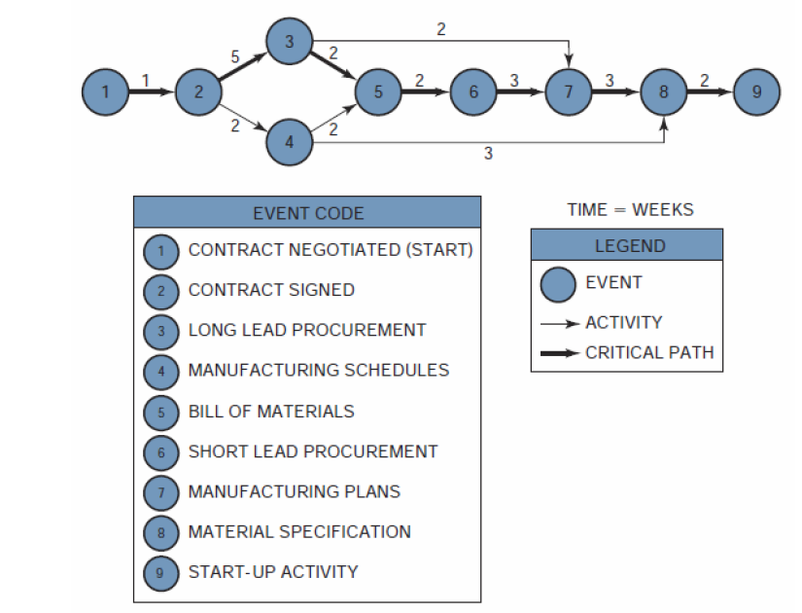
PERT Diagram
TE = 3
TL = 6
Slack = 6 -3 = 3
TE = the earliest time (date) on which an event can be expected to take place
TL= the latest date on which an event can take place without extending the completion date of the project
Slack time = TL -TE
Notes:
Since there exists only one path through the network that is the longest, the
other paths must be either equal in length to or shorter than that path. Therefore, there must exist events and activities that can be completed before the time when they are actually needed. The time differential between the scheduled completion date and the required date to meet critical path is referred to as the slack time. In Figure 3.4, event 4 is not on the crucial path. To go from event 2 to event 5 on the critical path requires seven weeks taking the route 2–3–5. If route 2–4–5 is taken, only four weeks are required. Therefore, event 4, which requires two weeks for completion, should begin anywhere from zero to three weeks after event 2 is complete.
Event 1 serves as the reference point for the network and could just as easily have been defined as a calendar date. As before, the critical path is represented as a bold line. The events on the critical path have no slack (i.e., TL =TE) and provide the boundaries for the noncritical path events.5 Since event 2 is critical, TL = TE 3 + 7= 10 for event 5. Event 6 terminates the critical path with a completion time of fifteen weeks.
The earliest time for event 3, which is not on the critical path, would be two weeks (TE 0 + 2= 2), assuming that it started as early as possible. The latest allowable date is obtained by subtracting the time required to complete the activity from events 3 to 5 from the latest starting date of event 5. Therefore, TL (for event 3) =10 - 5 = 5 weeks. Event 3 can now occur anywhere between weeks 2 and 5 without interfering with the scheduled completion date of the project. This same procedure can be applied to event 4, in which case TE 6 and TL 9.

Slide 29
Scheduling from Estimates
Critical Path
Longest time through the network diagram, the shortest time the project is expected to take
Slack (or Float)
The amount of time a task can be delayed without impacting the project
Calculated using:
Late Start – Early Start (LS-ES)
Or
Late Finish – Early Finish (LF-EF)
Early Starts computed by making a “forward pass” through the network while late starts are computed using a “backward pass”

Slide 30
Critical Path Determination
EF=ES+DUR-1
LS=LF-DUR+1
Slack=LF-EF or LS-ES
ES
DUR
EF
Task Name
LS
Slack
LF
3
2
4
Task B
1
2
2
7
4
8
9
2
10
Task A
Task D
1
0
2
3
6
8
9
0
10
Task C
3
0
8

Slide 31
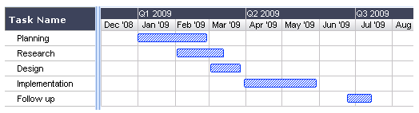
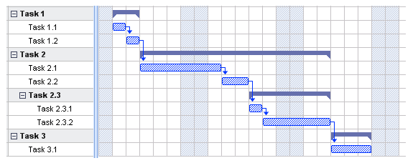
GANTT CHART
What is a Gantt Chart?
Shows you what has to be done (the activities/task) and when (the schedule)
Use it during status update meetings, reports, etc.
How to…
Determine what tasks must be done
Determine when each task should begin and ends
List the activities in chronological order
Visualise how long each activity is scheduled to last
Why is this useful?
Clarity. Ability to boil down multiple tasks and timelines into a single view/document.
Communication. Easy, visual method to help team members understand what must be done when.
Time management & coordination. Helps teams understand the overall impact of project delays and can foster stronger collaboration while encouraging better task organization
Efficiency. For instance, while one team member waits on the outcome of three other tasks before starting a crucial piece of the assignment, he or she can perform other project tasks.
Accountability. Use it during critical projects to track team progress, highlighting both big wins and major failures.
Simple Gantt chart
Gantt chart showing tasks and sub-tasks

Slide 32
Budgeting

Slide 33
Introduction
Budgets are plans for allocating organizational resources to project activities.
forecasting required resources, quantities needed, when needed, and costs
Budgets help tie project to overall organizational objectives.
Budgets can be used as tool by upper management to monitor and guide projects.

Slide 34
Top-Down Budgeting
Based on collective judgements and experiences of top and middle managers.
Overall project cost estimated by estimating costs of major tasks
Advantages
accuracy of estimating overall budget
errors in funding small tasks need not be individually identified

Slide 35
Bottom-Up Budgeting
WBS or action plan identifies elemental tasks
Those responsible for executing these tasks estimate resource requirements
Advantage
more accurate in the detailed tasks
Disadvantage
risk of overlooking tasks

Slide 36
Types of costs
Fixed Costs: These costs stay the same and do not change throughout the project life cycle. Examples of fixed costs include setup costs, rental costs etc.
Variable Costs: Variable costs are costs that change with the amount of work. Examples of variable costs are hourly labor, the cost of material, the cost of supply, fuel for bulldozer etc.
Direct Costs: Direct costs are expenses that are billed directly to the project. Examples of direct costs are team travel expenses, team wages, the cost of material used in a project, costs incurred for materials used to construct a building.
Indirect Costs: Indirect costs are costs that are shared and allocated among several or all projects. Examples include fringe benefits and taxes. Another example of indirect costs could be the salary of an architect or a project manager who is partially allocated across many projects.
Sunk Costs: Sunk costs are costs that have been incurred on a project but have not produced value towards the project objectives. Sunk costs are like spilled milk.If they are unrecoverable, they are to be treated as if they are irrelevant.
Overhead Costs: Overhead costs are those general costs that are the costs of doing business not directly attributed to any one individual. They are shared proportionally across the project as a percentage. Eg. Telephone, office expenses.
Notes:
As an example lets say a contractor does R1m business for the year. He calculates that his running expenses is 100000 then his overhead cost is 10%

Slide 37
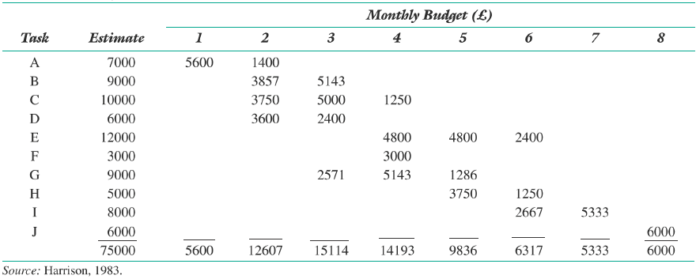
Project Budget by Task & Month

Slide 38
Risk Management

Slide 39
What is risk ?
Project risk is an uncertain event or condition, that, if it occurs, has a positive or a negative effect on a project objective (cost, time, quality).
A risk has a cause and, if it occurs, a consequence.
In risk management, probability and impact (severity) of the risks are considered.

Slide 40
Project Risk Management Processes
Planning risk management : Deciding how to approach and plan the risk management activities for the project
Identifying risks: Determining which risks are likely to affect a project and documenting the characteristics of each
Performing qualitative risk analysis: Prioritizing risks based on their probability and impact of occurrence

Slide 41
Project Risk Management Processes (cont’d)
Performing quantitative risk analysis: Numerically estimating the effects of risks on project objectives
Planning risk responses: Taking steps to enhance opportunities and reduce threats to meeting project objectives
Monitoring and Controlling risk: Monitoring identified and residual risks, identifying new risks, carrying out risk response plans, and evaluating the effectiveness of risk strategies throughout the life of the project

Slide 42
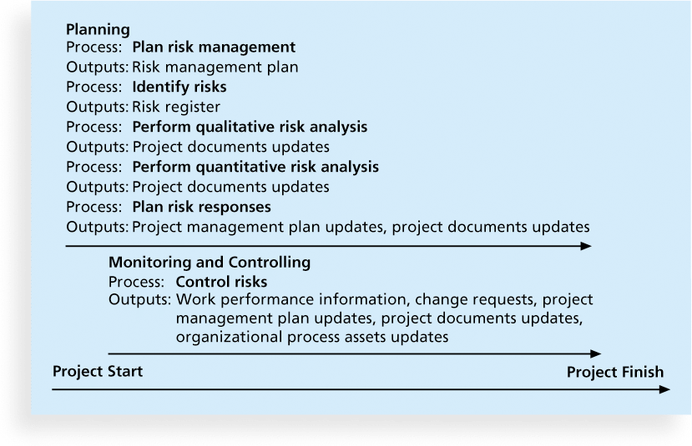
Project Risk Management Summary

Slide 43
Topics Addressed in a Risk Management Plan
Methodology
Roles and responsibilities
Budget and schedule
Risk categories
Risk probability and impact
Revised stakeholders’ tolerances
Tracking
Risk documentation
Notes:
The main output of this process is a risk management plan—a plan that documents the procedures for managing risk throughout a project

Slide 44
Broad Categories of Risk
Market risk
Financial risk
Technology risk
People risk
Structure/process risk

Slide 45
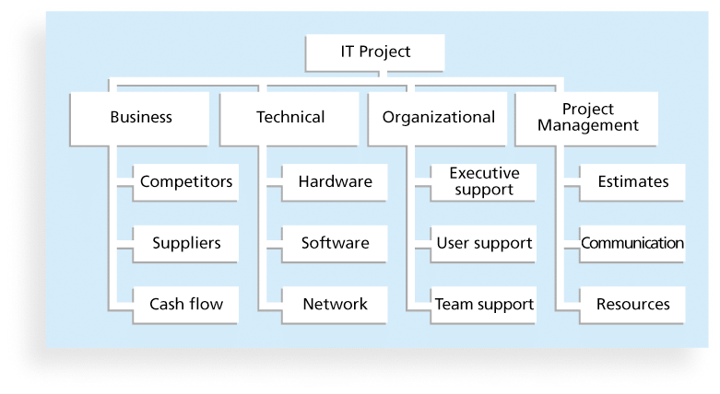
Figure 11-4. Sample Risk Breakdown Structure
Notes:
A risk breakdown structure is a hierarchy of potential risk categories for a project
Similar to a work breakdown structure but used to identify and categorize risks

Slide 46
Identifying Risks
Identifying risks is the process of understanding what potential events might hurt or enhance a particular project
Another consideration is the likelihood of advanced discovery
Risk identification tools and techniques include:
Brainstorming
The Delphi Technique
Interviewing
SWOT analysis
Notes:
The Delphi Technique is used to derive a consensus among a panel of experts who make predictions about future developments
Provides independent and anonymous input regarding future events
Uses repeated rounds of questioning and written responses and avoids the biasing effects possible in oral methods, such as brainstorming

Slide 47
Risk Register
The main output of the risk identification process is a list of identified risks and other information needed to begin creating a risk register
A risk register is:
A document that contains the results of various risk management processes and that is often displayed in a table or spreadsheet format
A tool for documenting potential risk events and related information
Risk events refer to specific, uncertain events that may occur to the detriment or enhancement of the project

Slide 48
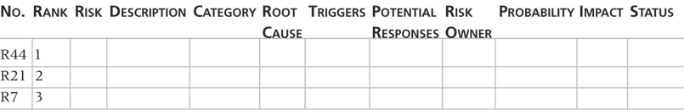
Sample Risk Register
• No.: R44
• Rank: 1
• Risk: New customer
• Description: We have never done a project for this organization before and don’t know too much about them. One of our company’s strengths is building good customer relationships, which often leads to further projects with that customer. We might have trouble working with this customer because they are new to us.
• Category: People risk
• Etc.

Slide 49
Probability/Impact Matrix
A probability/impact matrix or chart lists the relative probability of a risk occurring on one side of a matrix or axis on a chart and the relative impact of the risk occurring on the other
List the risks and then label each one as high, medium, or low in terms of its probability of occurrence and its impact if it did occur
Can also calculate risk factors:
Numbers that represent the overall risk of specific events based on their probability of occurring and the consequences to the project if they do occur

Slide 50
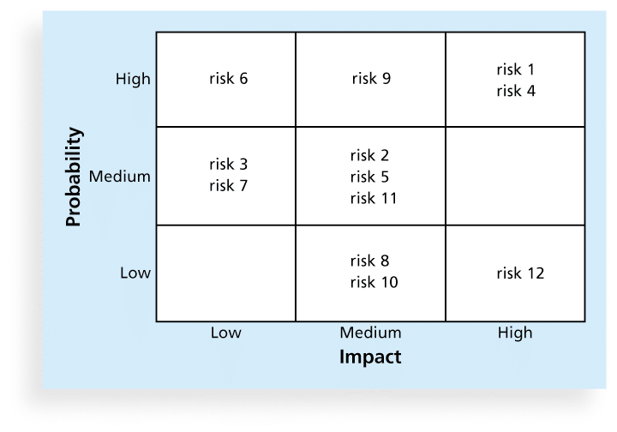
Sample Probability/Impact Matrix

Slide 51
Performing Quantitative Risk Analysis
Often follows qualitative risk analysis, but both can be done together
Large, complex projects involving leading edge technologies often require extensive quantitative risk analysis
Main techniques include:
Decision tree analysis
Simulation
Sensitivity analysis

Slide 52
Planning Risk Responses
After identifying and quantifying risks, you must decide how to respond to them
Four main response strategies for negative risks:
Risk avoidance
Risk acceptance
Risk transference
Risk mitigation
Notes:
Avoid – change plan/strategy to avoid the risk
Accept – Take the risk
Transfer – 3rd party eg. Insurance
Mitigate – Reduce the risk. Eg. Work procdures or safety equipment.

Slide 53
Controlling Risks
Involves executing the risk management process to respond to risk events and ensuring that risk awareness is an ongoing activity performed by the entire project team throughout the entire project
Workarounds are unplanned responses to risk events that must be done when there are no contingency plans
Main outputs of risk control are:
Work performance information
change requests
updates to the project management plan, other project documents, and organizational process assets

Slide 54
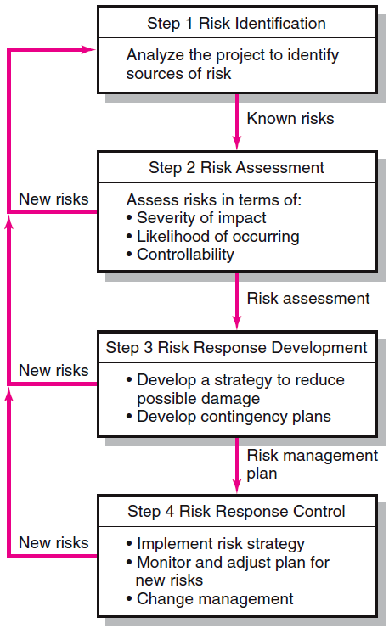
Risk Management Process
Generate a list of possible risks through
brainstorming,
historical data,
risk profiling.
Conduct scenario analysis for event probability and impact.
Compile risk assessment matrix
Conduct Failure Mode and Effects Analysis (FMEA)
Mitigate the risk
Avoid the risk
Transfer the risk
Retain the risk
Execute risk response strategy
Initiate contingency plans
Watch for new risks
Repeat risk identification exercise
Document risk resolution
Notes:
As an example lets say a contractor does R1m business for the year. He calculates that his running expenses is 100000 then his overhead cost is 10%

Slide 55
Quality

Slide 56
TQM
Total Quality Management TQM, describes a management approach to long-term success through customer satisfaction. In a TQM effort, all members of an organization participate in improving processes, products, services, and the culture in which they work.
The 8 principles of total quality management:
1. Customer-focused
2. Total employee involvement
3. Process-centred
4. Integrated system
5. Strategic and systematic approach
6. Continual improvement
7. Fact-based decision making
8. Communications
Notes:
Total Quality Management TQM, also known as total productive maintenance, describes a management approach to long-term success through customer satisfaction. In a TQM effort, all members of an organization participate in improving processes, products, services, and the culture in which they work.

Slide 57
ISO 9001
ISO 9001 is the international standard that specifies requirements for a quality management system (QMS). Organizations use the standard to demonstrate the ability to consistently provide products and services that meet customer and regulatory requirements.
The 8 principles of total quality management:
1. Customer-focused
2. Total employee involvement
3. Process-centred
4. Integrated system
5. Strategic and systematic approach
6. Continual improvement
7. Fact-based decision making
8. Communications
Notes:
Total Quality Management TQM, also known as total productive maintenance, describes a management approach to long-term success through customer satisfaction. In a TQM effort, all members of an organization participate in improving processes, products, services, and the culture in which they work.

Slide 58
ISO 9001
ISO 9001 is the international standard that specifies requirements for a quality management system (QMS). Organizations use the standard to demonstrate the ability to consistently provide products and services that meet customer and regulatory requirements.
ISO 9001 is based on the idea of continual improvement.
It doesn’t specify what the objectives relating to “quality” or “meeting customer needs” should be, but requires organizations to define these objectives themselves and continually improve their processes in order to reach them.

Slide 59
Six Sigma
Six Sigma is “a comprehensive and flexible system for achieving, sustaining, and maximizing business success. Six Sigma is uniquely driven by close understanding of customer needs, disciplined use of facts, data, and statistical analysis, and diligent attention to managing, improving, and reinventing business processes.”
Six Sigma projects normally follow a five-phase improvement process called DMAIC
Information Technology Project Management, Fifth Edition, Copyright 2007

Slide 60
DMAIC
DMAIC is a systematic, closed-loop process for continued improvement that is scientific and fact based
Define: Define the problem/opportunity, process, and customer requirements. Tool used include project charter, requirements, Voice of the Customer data.
Measure: Define measures (in terms of defects per million), then collect, compile, and display data
Analyze: Scrutinize process details to find improvement opportunities; seeks root cause of problems
Improve: Generate solutions and ideas for improving the problem; pilot test the solution
Control: Track and verify the stability of the improvements and the predictability of the solution

